Slide 1

Chapter 10:
Project Communications Management
Information Technology Project Management, Seventh Edition
Note: See the text itself for full citations.

Slide 2
讨论问题
1、项目沟通管理的5个过程
2、项目沟通管理计划应包括哪些内容？
3、发布信息应该注意哪些方面？
4、期望管理矩阵包括哪些条目？
5、绩效报告
6、改善沟通的一些建议
7、如何有效开会？
8、如何更高效使用电子邮件或其他通讯工具？

Slide 3
Learning Objectives
Understand the importance of good communications on projects and the need to develop soft skills, especially for IT project managers and their teams
Review key concepts related to communications
Explain the elements of planning project communications and how to create a communications management plan
Describe how to manage communications, including communication technologies, media, and performance reporting

Slide 4
Learning Objectives (cont’d)
Discuss methods for controlling communications to ensure that information needs are met throughout the life of the project
List various methods for improving project communications, such as running effective meetings, using various technologies effectively, and using templates
Describe how software can enhance project communications management

Slide 5
Importance of Good Communications
The greatest threat to many projects is a failure to communicate
Our culture does not portray IT professionals as being good communicators
Research shows that IT professionals must be able to communicate effectively to succeed in their positions
Strong verbal and non-technical skills are a key factor in career advancement for IT professionals

Slide 6
Project Communications
Management Processes
Planning communications management: Determining the information and communications needs of the stakeholders
Managing communications: Creating, distributing, storing, retrieving, and disposing of project communications based on the communications management plan
Controlling communications: Monitoring and controlling project communications to ensure that stakeholder communication needs are met

Slide 7
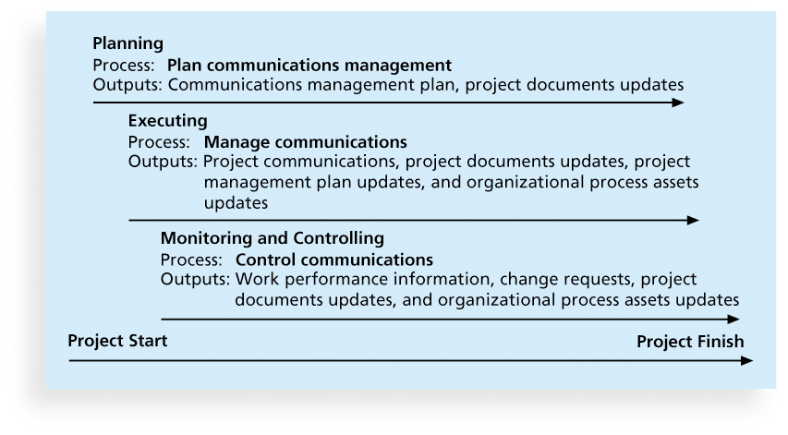
Figure 10-1. Project Communications Management Summary

Slide 8
Keys to Good Communications
Project managers say they spend as much as 90 percent of their time communicating
Need to focus on group and individual communication needs
Use formal and informal methods for communicating
Distribute important information in an effective and timely manner
Set the stage for communicating bad news
Determine the number of communication channels

Slide 9
Understanding Group and Individual Communication Needs
People are not interchangeable parts
As illustrated in Brooks’ book The Mythical Man-Month, you cannot assume that a task originally scheduled to take two months of one person’s time can be done in one month by two people
Nine women cannot produce a baby in one month!

Slide 10
Importance of Face-to-Face Communication
Research says that in a face-to-face interaction:
  58 percent of communication is through body language.
  35 percent of communication is through how the words are said
  7 percent of communication is through the content or words that are spoken
Pay attention to more than just the actual words someone is saying
A person’s tone of voice and body language say a lot about how he or she really feels

Slide 11
Personal Preferences Affect Communication Needs
Introverts like more private communications, while extroverts like to discuss things in public
Intuitive people like to understand the big picture, while sensing people need step-by-step details
Thinkers want to know the logic behind decisions, while feeling people want to know how something affects them personally
Judging people are driven to meet deadlines while perceiving people need more help in developing and following plans

Slide 12
Encouraging More Face-to-Face Interactions
Short, frequent meetings are often very effective in IT projects
Stand-up meetings force people to focus on what they really need to communicate
Some companies have policies preventing the use of e-mail between certain hours or even entire days of the week

Slide 13
Distributing Information in an Effective and Timely Manner
Don’t bury crucial information
Don’t be afraid to report bad information
Oral communication via meetings and informal talks helps bring important information—good and bad—out into the open

Slide 14
Other Communication Considerations
Rarely does the receiver interpret a message exactly as the sender intended
Geographic location and cultural background affect the complexity of project communications
  Different working hours
  Language barriers
  Different cultural norms

Slide 15
Determining the Number of Communications Channels
As the number of people involved increases, the complexity of communications increases because there are more communications channels or pathways through which people can communicate.
Number of communications channels = n(n-1)
2
where n is the number of people involved

Slide 16
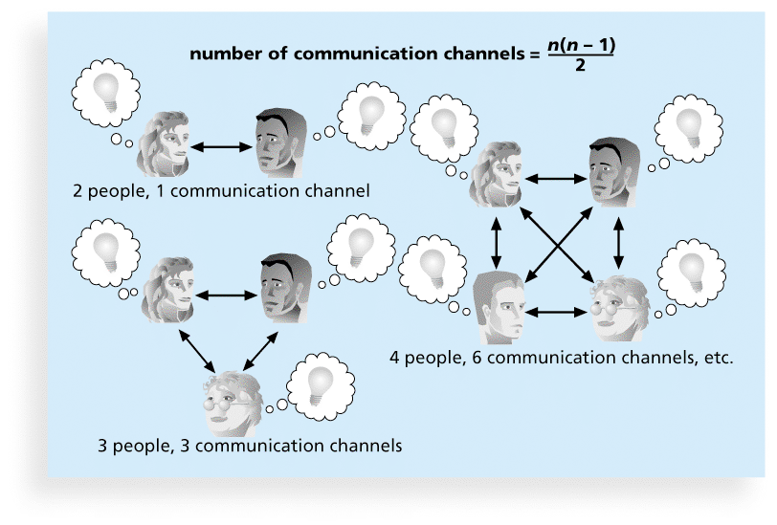
Figure 10-2. The Impact of the Number of People on Communications Channels

Slide 17
Planning Communications Management
Every project should include some type of communications management plan, a document that guides project communications
The communications management plan varies with the needs of the project, but some type of written plan should always be prepared
For small projects, the communications management plan can be part of the team contract
For large projects, it should be a separate document

Slide 18
Communications Management
Plan Contents
1. Stakeholder communications requirements
2. Information to be communicated, including format, content, and level of detail
3. Who will receive the information and who will produce it
4. Suggested methods or technologies for conveying the information
5. Frequency of communication
6. Escalation procedures for resolving issues
7. Revision procedures for updating the communications management plan
8. A glossary of common terminology

Slide 19
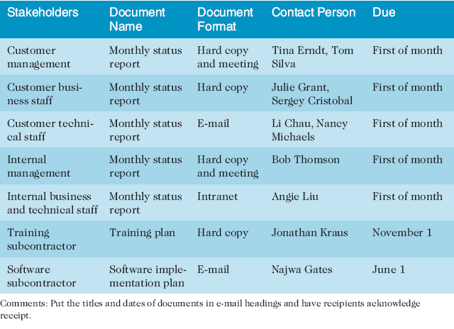
Table 10-1. Sample Stakeholder Analysis for Project Communications

Slide 20
Managing Communications
Managing communications is a large part of a project manager’s job
Getting project information to the right people at the right time and in a useful format is just as important as developing the information in the first place
Important considerations include the use of technology, the appropriate methods and media to use, and performance reporting

Slide 21
Using Technology to Enhance Creation and Distribution
Technology can facilitate the process of creating and distributing information, when used properly
It is important to select the appropriate communication method and media

Slide 22
Global Issues
Natural disasters often disrupt communications around the world. For example, the scale of the damage to Japan’s communications infrastructure after a 9.0 magnitude earthquake in March 2011 was unprecedented. Fortunately, thousands of employees from NTT East worked around the clock to restore communications. As a result of their efforts, 4.75 million public phone calls were made on the day after the disaster.

Slide 23
Classifications for Communication Methods
Interactive communication: Two or more people interact to exchange information via meetings, phone calls, or video conferencing. Most effective way to ensure common understanding
Push communication: Information is sent or pushed to recipients without their request via reports, e-mails, faxes, voice mails, and other means. Ensures that the information is distributed, but does not ensure that it was received or understood
Pull communication: Information is sent to recipients at their request via Web sites, bulletin boards, e-learning, knowledge repositories like blogs, and other means

Slide 24
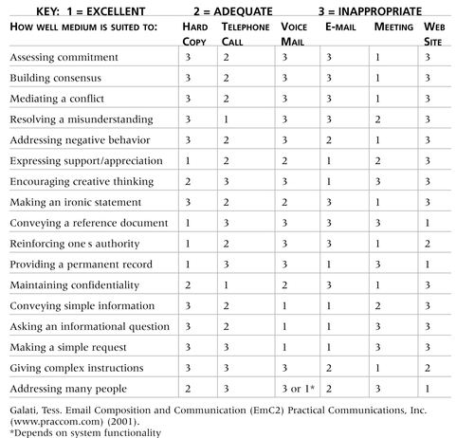
Table 10-2. Media Choice Table

Slide 25
Reporting Performance
Performance reporting keeps stakeholders informed about how resources are being used to achieve project objectives
  Status reports describe where the project stands at a specific point in time
  Progress reports describe what the project team has accomplished during a certain period of time
  Forecasts predict future project status and progress based on past information and trends

Slide 26
Controlling Communications
The main goal of controlling communications is to ensure the optimal flow of information throughout the entire project life cycle
The project manager and project team should use their various reporting systems, expert judgment, and meetings to assess how well communications are working. If problems exist, the project manager and team need to take action, which often requires changes to the earlier processes of planning and managing project communications
It is often beneficial to have a facilitator from outside the project team assess how well communications are working

Slide 27
Suggestions for Improving Project Communications
Develop better communication skills
Run effective meetings
Use e-mail and other technologies effectively
Use templates for project communications

Slide 28
Developing Better Communication Skills
Most companies spend a lot of money on technical training for their employees, even when employees might benefit more from communications training
Individual employees are also more likely to enroll voluntarily in classes to learn the latest technology than in classes that develop soft skills
As organizations become more global, they realize they must invest in ways to improve communication with people from different countries and cultures
It takes leadership to improve communication

Slide 29
Running Effective Meetings
Determine if a meeting can be avoided
Define the purpose and intended outcome of the meeting
Determine who should attend the meeting
Provide an agenda to participants before the meeting
Prepare handouts and visual aids, and make logistical arrangements ahead of time
Run the meeting professionally
Set the ground rules for the meeting
Build relationships

Slide 30
Using E-Mail, Instant Messaging, Texting, and Collaborative Tools Effectively
Make sure that e-mail, instant messaging, texting, or collaborative tools are an appropriate medium for what you want to communicate
Be sure to send information to the right people
Use meaningful subject lines and limit the content of emails to one main subject, and be as clear and concise as possible
Be sure to authorize the right people to share and edit your collaborative documents

Slide 31
Sample Collaborative Tools
A SharePoint portal allows users to create custom Web sites to access documents and applications stored on shared devices
Google Docs allow users to create, share, and edit documents, spreadsheets, and presentations online
A wiki is a Web site designed to enable anyone who accesses it to contribute or modify Web page content

Slide 32
Using Templates for Project Communications
Many technical people are afraid to ask for help
Providing examples and templates for project communications saves time and money
Organizations can develop their own templates, use some provided by outside organizations, or use samples from textbooks
Recall that research shows that companies that excel in project management make effective use of templates

Slide 33
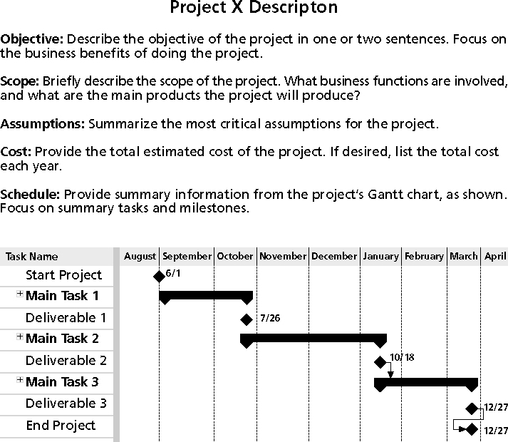
Figure 10-3. Sample Template for a
Project Description (corrected from p. 427)

Slide 34
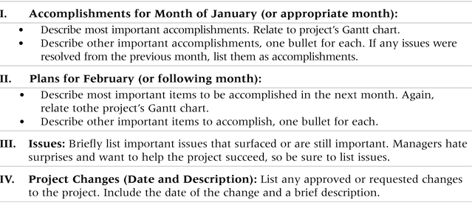
Table 10-3. Sample Template for a Monthly Progress Report

Slide 35
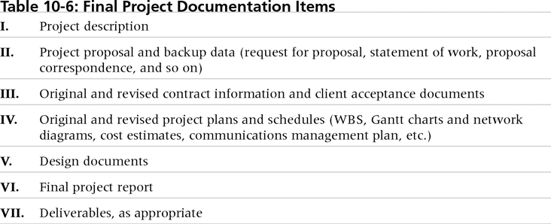
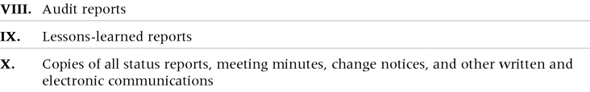
Table 10-4. Final Project
Documentation Items

Slide 36
Lessons Learned Reports
The project manager and project team members should each prepare a lessons-learned report
  A reflective statement that documents important things an individual learned from working on the project
The project manager often combines information from all of the lessons-learned reports into a project summary report
See template and sample in Chapter 3

Slide 37
Project Archives
It is also important to organize and prepare project archives
Project archives are a complete set of organized project records that provide an accurate history of the project
These archives can provide valuable information for future projects as well

Slide 38
Project Web Sites
Many project teams create a project Web site to store important product documents and other information
Can create the site using various types of software, such as enterprise project management software

Slide 39
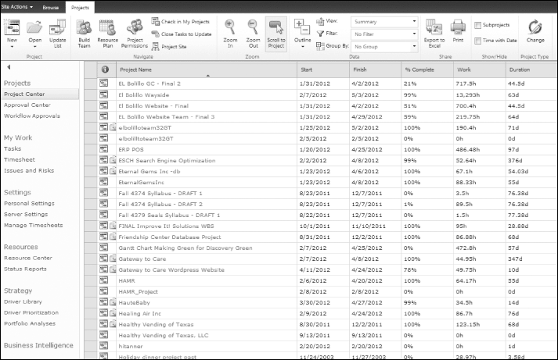
Figure 10-4. Microsoft’s Project Web Application Master Project Summary Screen

Slide 40
Using Software to Assist in Project Communications
There are many software tools to aid in project communications
Today many people telecommute or work remotely at least part-time. TechCast at George Washington University forecasts that by 2019, 30 percent of U.S. private-sector workers could work from home
Project management software includes new capabilities to enhance virtual communications
While technology can aid in the communications process, it is not the most important. Far more important is improving an organization’s ability to communicate, which often involves cultural change

Slide 41
Chapter Summary
The goal of project communications management is to ensure timely and appropriate generation, collection, dissemination, storage, and disposition of project information
Main process include:
  Plan communications management
  Manage communications
  Control communications

Slide 42
讨论问题
1、项目沟通管理的5个过程
2、项目沟通管理计划应包括哪些内容？
3、发布信息应该注意哪些方面？
4、期望管理矩阵包括哪些条目？
5、绩效报告
6、如何有效开会？
7、改善沟通的一些建议
8、如何更高效使用电子邮件或其他通讯工具？

Slide 43
讨论问题
1、项目沟通管理的5个过程
识别利益相关者；
规划沟通；
分布信息；
管理利益相关者期望；
报告绩效；

Slide 44
讨论问题
2、沟通管理计划应包括哪些内容？
干系人的沟通需求；
需要沟通的信息，包括语言、内容、格式、详细程度；
产生和接收信息的个人或小组；
传达信息的推荐方式或技术；
沟通频率；
为解决问题所需的向上提报程序；
更新沟通管理计划的再版程序；
常用术语表；

Slide 45
讨论问题
3、良好沟通的关键？
增加沟通的频次；
理解小组和个人的沟通需求；
同时使用正式与非正式沟通；
用有效、适时的方式发布重要信息；
选择适当的交流媒介；
为坏消息搭建语境；
确定沟通渠道的数量；

Slide 46
讨论问题
4、期望管理矩阵包括哪些条目？
标准；
优先权；
期望；
各项标准的衡量指南；

Slide 47
讨论问题
5、绩效报告包括
状态报告；
进度报告；
预测；

Slide 48
讨论问题
6、改善沟通的一些建议
使用沟通技巧来管理冲突；
开发更好的沟通技巧；
召开有效的会议；
有效使用电子邮件、即时通讯等协作工具；
使用项目沟通模板；

Slide 49
讨论问题
7、如何有效开会？
确定会议是否必要；
定义会议目的和预期产出；
决定会议参与人；
在会议开启前提供会议议程；
准备手稿和直观教具，提前做好后勤安排；
专业地开会；
为会议制定基本要求；
建立关系；

Slide 50
讨论问题
8、如何更高效使用电子邮件或其他通讯工具？
选择最适合的媒介；
确保信息发送给了正确的人；
在邮件中使用有意义的主题行，并尽量将内容限制在一个主题下，如果有其他主题，那么就发另外的邮件；
确保授权了合适的人来分享协作文档；

